Slide 1
CNN assessment

Slide 2
Background
CNN use grid sampling to learn from the model and try to guess the maximum location.

Slide 3
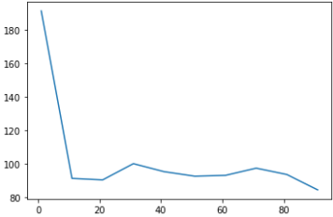
Measurements v.s. snr
Includes fail experiments
Limits: if the experiment fail, then the measurements are set to 200
It might not be precise between snr 0 and 5, but after 5, it is all successful

Slide 4
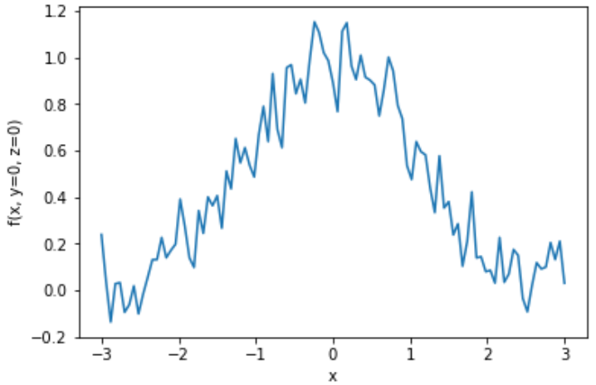
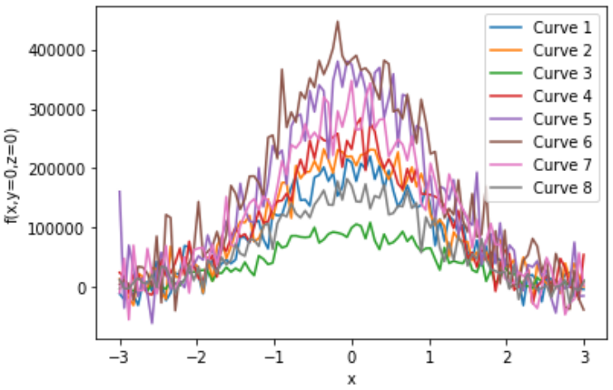
Issues
CNN and Gradient search has different strategy. Therefore, we use different gaussian model.
Gradient:
f_gaussian = gaussian+ noise
CNN:
A* gaussian + (A+B)*noise + C
where A=random int(3000, 493000)
B=C=random int(300,7000)

Slide 5
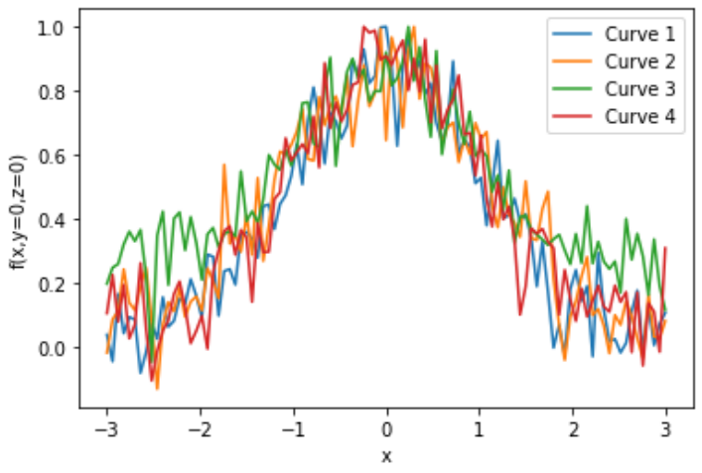
Input of CNN
Snr=10
After normalizing

Slide 6
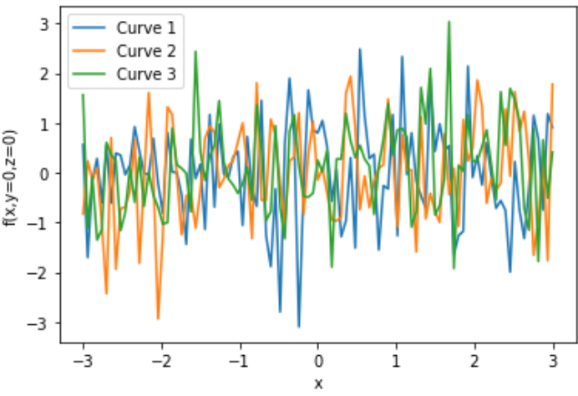
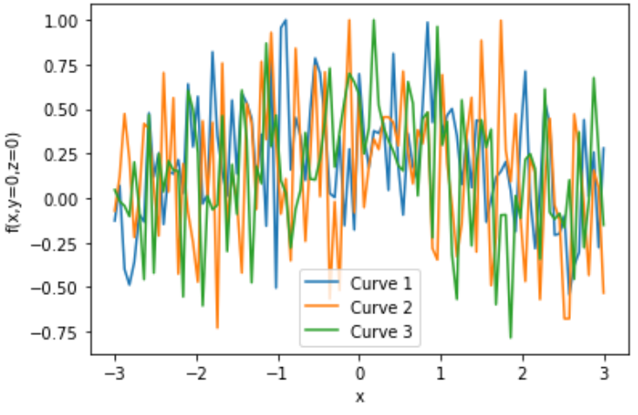
Comparison of GS and CNN in low snr
Left GS, Right CNN
SNR=3

